Slide 1
THE CHOSEN EPISODE FOUR

Slide 2
MEET THE BIBLICAL CHARACTERS

Slide 3
JOHN THE BAPTIST
John was the foretold forerunner of Jesus who called Jews to repent in preparation for the Messiah. John and Jesus were cousins.
After a faithful ministry, he was imprisoned for his unpopular message and beheaded by Herod.
John baptizes Jesus

Slide 4
JAMES & JOHN, SONS OF ZEBEDEE
Become with Peter Jesus’ closest disciples.
James probably older than John as he is always mentioned first
Left everything to follow Jesus after miraculous catch of fish
James was the first apostle to be martyred in AD 44. (Acts 12:1 – 5)
John one of key leaders in early church

Slide 5
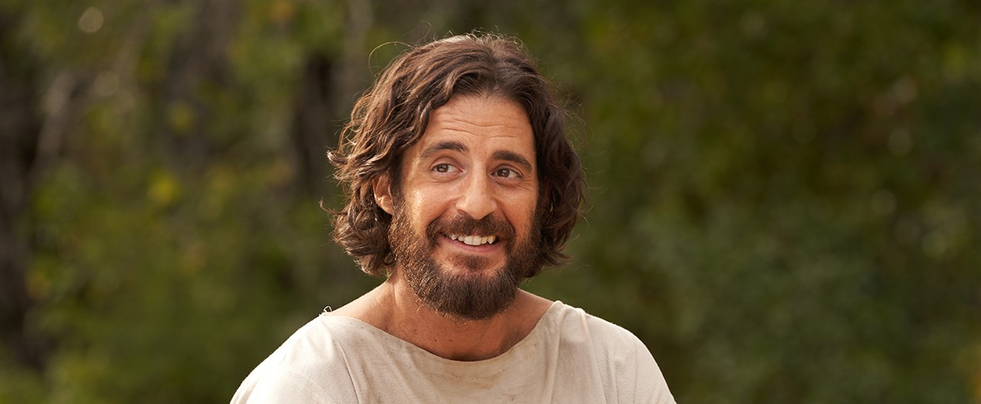
JESUS

Slide 6
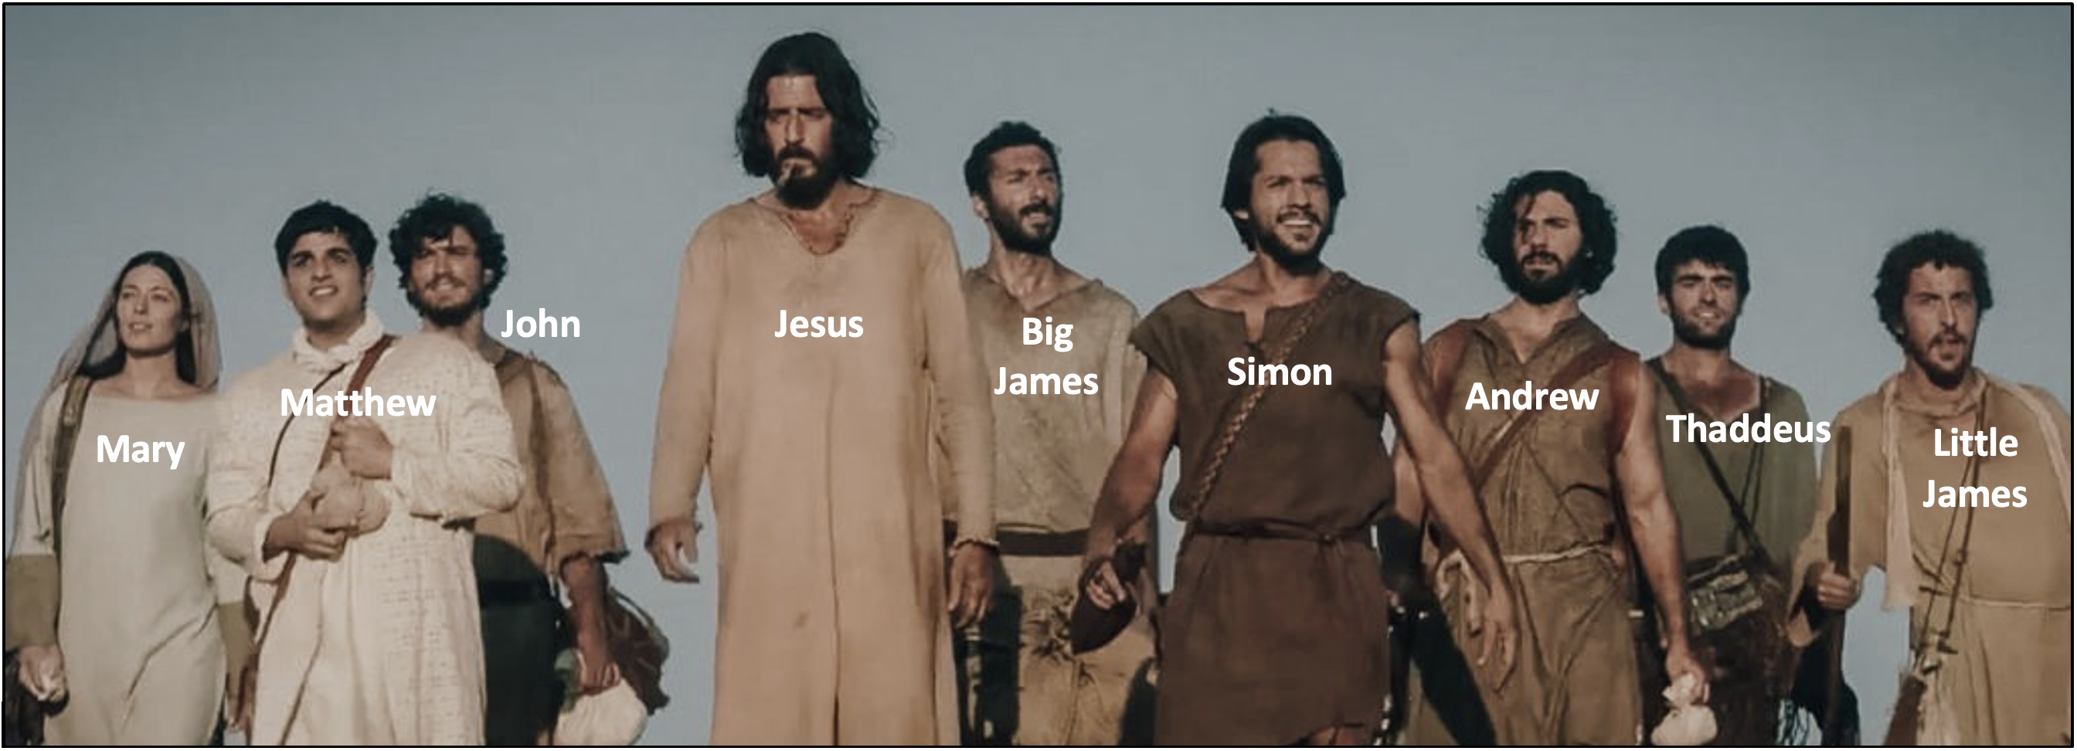
THE GUYS

Slide 7
EPISODE OVERVIEW

Slide 8
EPISODE OVERVIEW
Simon is playing a dangerous game with the Romans. Things are spinning out of control, Simon & Andrew are on brink of disaster and despite Eden’s promptings to return to God, Simon continues to try to fix it on his own.
After a night of fruitless fishing, Simon experiences a miracle catch of fish and meets Jesus who changes the course of his life, alongside the lives of Andrew, James & John as Jesus invites them to follow him and become his disciples.
We meet John the Baptist – his actions and teachings are described by the Pharisees as they debate what to do about him. Nicodemus comes to visit him in prison to see if he is the miracle man.

Slide 9
TABLE TALK
What struck you most about this episode? What characters most stood out for you?
What did you learn about Jesus in this episode?
Why do you think Peter was so moved by this miraculous catch of fish?
Jesus told the fisher brothers that they would become fishers of people. What did that mean for them? What does that mean for you? In what ways are you “fishing for people” as you follow Jesus? How does that relate to our call to be missionary disciples?
Do you believe God allows adverse circumstances in your life to draw you back to God? Have you ever experienced this?
Do you believe miracles happen today? Do you have an experience of a miracle you can share?
The night on the Sea of Galilee amplified the encounter with Jesus in the morning. Have you ever experienced Jesus coming to you after “a dark night”? Would you share this?

