Slide 1
THE CHOSEN EPISODE TWO

Slide 2
MATTHEW 11: 28 - 30
(Jesus said,) “Come to me, all who labour and are burdened, and I will give you rest. Take my yoke upon you, and learn from me, for I am gentle and humble of heart, and you will find rest for your soul. For my yoke is easy, and my burden is light.”

Slide 3
OPENING PRAYER God is our refuge and our strength, our ever - present help in distress. Though the earth trembles, and mountains slide into the sea, we have no fear. Waters foam and roar, and mountains shake at their surging, but the God of hosts is with us – our stronghold, the God of Israel There is a river whose streams give joy to the city of God, the holy dwelling of the Most High. God is in its midst; it stands firm. God will aid it at the break of day. Even if nations are in chaos, and kingdoms fall, God’s voice resounds, the earth melts away. Yahweh is with us; the God of Israel is our stronghold. Come! See the deeds of the Most High, the marvelous things God has done on earth. All over the world, God has stopped wars – breaking bows, splintering spears, burning the shields with fire. “Be still! And know that I am God, exalted among the nations, exalted upon the earth.” The Most High is with us, our stronghold is the God of Israel.

Slide 4
IMAGINATIVE PRAYER

Slide 5
IMAGINATIVE PRAYER IGNATIAN CONTEMPLATION
Way of praying by imagining oneself inside a scene from the gospels and encountering Jesus there. Way to meet Jesus face to face.
God speaks to us through our imagination & the Holy Spirit makes present a mystery of Jesus’ life in a way that is meaningful for us now. Makes the Jesus of the Gospel our Jesus.
Use imagination to dig deeper into story so God may communicate with us in a personal manner.
Opportunity to enter conversation with God or simply enjoy God’s loving presence.

Slide 6
PREPARATIONS FOR PRAYER
Find a comfortable posture, relax, breathe slowly and deeply for a minute or two.
Recall that you are in the presence of God and offer yourself to God
Pray for guidance ask the Lord to speak to you through this prayer
Ask God for the grace you hope to receive: what do you hope to gain from this time of prayer?
Slowly read the gospel passage once or twice so that you can remember the events. Then put the text away & begin to imagine the story in detail - be as specific as possible

Slide 7
IMAGINING IN PRAYER
Enter gospel, let action of story unfold by itself under guidance of Holy Spirit. Do not actively direct actions. Participate in whatever way seems natural.
Picture the setting
Imagine the scenery, the landscape, the environment, buildings
What time and kind of day is it?
Engage all senses : touch, smell, sound, sight, taste
See & hear the people
Who are the characters? What are they doing? Observe their actions
What do they look like? What are they wearing?
What does Jesus look like? What is he wearing? How do others react to him.

Slide 8
What is Jesus doing? Who is he interacting with?
What are the people saying to each other?
What is Jesus saying and how does he talk to and treat those he encounters?
Be there with the mystery
Who are you in the scene – a central character, an observer, someone to be healed or helping others to Jesus
What do you feel? What are you doing?
Time for conversation with Jesus “as one friend speaks to another”. Picture him present before you, ask him questions or say whatever you need to say to him. Take some time to listen for his response. What might he be telling or showing you?

Slide 9
ENDING IMAGINATIVE PRAYER
Pray the Our Father
Take time to reflect on what stood out for you the most from your prayer:
How did you feel during this time of prayer?
What struck you the most?
What was the most consoling moment of prayer? The most challenging?
When did you feel closest to God?

Slide 10
On a Sabbath Jesus was teaching in one of the synagogues, and a woman was there who had been crippled by a spirit for eighteen years. She was bent over and could not straighten up at all. When Jesus saw her, he called her forward and said to her, woman, you are set free from your infirmity. Then he put his hands on her, and immediately she straightened up and praised God.
Indignant because Jesus had healed on the Sabbath, the synagogue leader said to the people,” There are six days for work. So come and be healed on those days, not on the Sabbath.”
The Lord answered him, “You hypocrites! Doesn’t each of you on the Sabbath untie your ox or donkey from the stall and lead it out to give it water? Then should not this woman, a daughter of Abraham, whom Satan has kept bound for eighteen long years, be set free on the Sabbath day from what bound her?
When he said this, all his opponents were humiliated, but the people were delighted with all the wonderful things he was doing.

Slide 11
MEET THE BIBLICAL CHARACTERS

Slide 12
James (Son of Alphaeus)
Not James the brother of John, we meet him later
Who he is not clear in movie
Disciple of Jesus, and if he is the son of Alphaeus, an apostle

Slide 13
THADDEUS
Disciple about whom not much is known.
Mentioned in lists of 12 apostles in Mark 3:13 -19 & Matthew 10: 1 – 4
Not in List of apostles in Luke 6: 12 – 16 or Acts 1:13

Slide 14
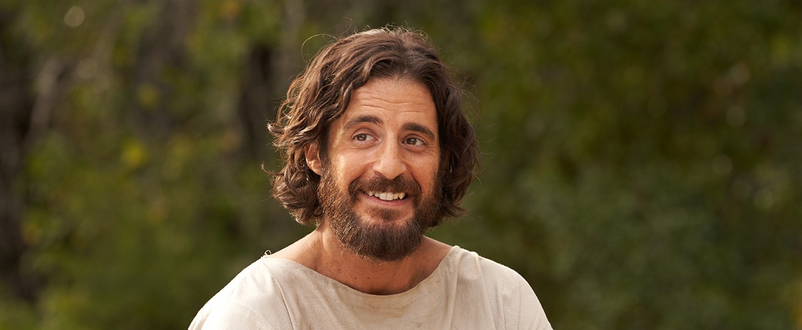
JESUS

Slide 15
EPISODE OVERVIEW

Slide 16
OVERVIEW OF EPISODE
See Mary completely restored and hosting her first Shabbat dinner.
Shabbat is shown from different perspectives.
We get a little more background on difficulties of being Jewish and living under Roman occupation.
Matthew validates Simon’s arrangement with Quintus.
Nicodemus investigates the miracle reported in the Red Quarter and becomes curious about Jesus.
We learn more about Jesus and his disciples.

Slide 17
TABLE TALK
What character stood out to you most? Which was most interesting? Most moving?
What impacted you most in this episode?
There are several different Shabbat dinners shown. What did you notice about the different Shabbat meals that we saw depicted?
How do you celebrate the Sabbath (Sunday)?
Why do you think Jesus chose to attend Mary’s Shabbat dinner? What does this tell you about Jesus? What else did you learn about Jesus?
How do you feel about the development of Simon’s character?
Why do you think Nicodemus is troubled about the news of Mary’s healing?
Mary says “I was one way and now I am completely different. And the thing that happened in between was him” Do you have a similar story about Jesus in your life to share? In what ways has your life gone from being one way to being another?
Mary says, “He called me by my name, I am his.” How does this speak to you? Do you experience yourself as belonging to Jesus? How?

